Slide 1
PRESENCE Bonus: Biblical Foundatons Part 3 Secular Objections & Conclusion
Nativity Communities of Faith
Fall 2019

Slide 2
Opening Prayer
Lord Jesus Christ, on the night of the Last Supper,
you begged your Heavenly Father for the gift of unity.
Through the intercession of the Blessed Virgin Mary,
may we who seek to be more united with God and one another be satisfied in our longing.
And may we satisfy Your longing, O Lord,
by helping others to know and love you in the Sacrament of Love,
you who live and reign with the Father and the Holy Spirit,
one God forever and ever.
Amen.
—based on John 17:20–22

Slide 3
Cor ad Cor Loquitur Heart Speaks to Heart
Take a few minutes to
re-connect and share
how the Spirit has moved you
in the weeks since our last meeting.

Slide 4
Introduction
“How can this man give us his flesh to eat?” These words uttered 2,000 years ago are echoed today. The doctrine of the Real Presence presents a difficulty for many people. When we take the time to understand the difficulties, we become better equipped to help address them. This can be done especially by showing how the Scriptures really do mean what the Church says they do.
This session examines objections to the Church’s Eucharistic teaching and provides scriptural answers for them. This apologetic helps us to give a reason for our faith and to gain a deeper insight into our faith.

Slide 5
JURNAL QUESTIONS
How would you compare your belief in the Eucharist with that of your parents & grandparents? What do you think young adults think about the Eucharist today?
Do you think belief in the Real Presence of the Lord in the Eucharist is anti-scientific?

Slide 6
PART ONE
Please open FORMED and view Presence
Bonus: Biblical Foundations,
Part Three: Source and Summit
Beginning at 55:00
Presence
Bonus: Biblical Foundations

Slide 7
OUTLINE
I. Secular Objections
A. You really believe that God is present?
1. Seems insane
2. Post-enlightenment: everything must be explained by reason or it’s not true
3. Excludes all faith
II. Response: faith is not contrary to reason, but goes above and beyond reason
A. Key Christian belief of the Eucharist stands with the Incarnation and Resurrection
B. It’s rational and reasonable to say God changes bread and wine into his Body and Blood, but it does take faith
C. Some truths do go beyond the comprehension of our reason; faith is necessary to have life

Slide 8
III. “Unless you eat the flesh … you have no life in you.”
A. Jesus is the lamb of the New Passover
1. Must eat the lamb
2. Must drink his blood to share divine life
B. The Bible is framed with the theme of eating and drinking for eternal life
1. Genesis: Tree of Life
2. Revelation, promises to those who conquer
a. 2:7 – promise to eat of the Tree of Life
b. 2:17 – promise of the hidden manna
c. 3:20 – promise to come in and eat
d. Climax in Revelation 19 – Wedding Feast of the Lamb
e. Also climax of John’s writings
C. Conclusion: Faith in the Eucharist is reasonable
1. Consistency of Scripture evidence of its divine origin
2. Evidence of Scripture points to centrality of the Real Presence in the Eucharist

Slide 9
Reflection 1
What was one thing from the video that you heard for the first time or that was an “aha” moment for you?
How do you understand the arc of the bible story from Genesis to Revelation as the story of the Eucharist?
What can you say to someone who thinks you are crazy to worship a “cookie?”
How seriously do you take the promise of eternal life? Why?

Slide 10
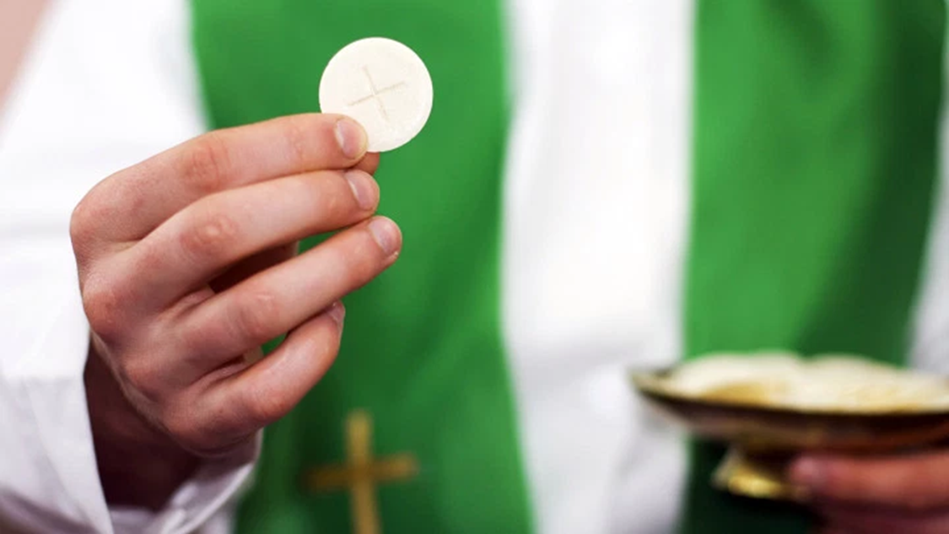
PART TWO

Slide 11
Just one-third of U.S. Catholics agree with their church that Eucharist is body, blood of Christ BY GREGORY A. SMITH AUGUST 5, 2019
Transubstantiation – the idea that during Mass, the bread and wine used for Communion become the body and blood of Jesus Christ – is central to the Catholic faith. Indeed, the Catholic Church teaches that “the Eucharist is ‘the source and summit of the Christian life.’”
But a new Pew Research Center survey finds that most self-described Catholics don’t believe this core teaching. In fact, nearly seven-in-ten Catholics (69%) say they personally believe that during Catholic Mass, the bread and wine used in Communion “are symbols of the body and blood of Jesus Christ.” Just one-third of U.S. Catholics (31%) say they believe that “during Catholic Mass, the bread and wine actually become the body and blood of Jesus.” Pew Research Study

Slide 12
In addition to asking Catholics what they believe about the Eucharist, the new survey also included a question that tested whether Catholics know what the church teaches on the subject. Most Catholics who believe that the bread and wine are symbolic do not know that the church holds that transubstantiation occurs. Overall, 43% of Catholics believe that the bread and wine are symbolic and also that this reflects the position of the church. Still, one-in-five Catholics (22%) reject the idea of transubstantiation, even though they know about the church’s teaching.
The vast majority of those who believe that the bread and wine actually become the body and blood of Christ – 28% of all Catholics – do know that this is what the church teaches. A small share of Catholics (3%) profess to believe in the real presence of Christ in the Eucharist despite not knowing the church’s teaching on transubstantiation. (ibid)

Slide 13
About six-in-ten (63%) of the most observant Catholics — those who attend Mass at least once a week — accept the church’s teaching about transubstantiation. Still, even among this most observant group of Catholics, roughly one-third (37%) don’t believe that the Communion bread and wine actually become the body and blood of Christ (including 23% who don’t know the church’s teaching and 14% who know the church’s teaching but don’t believe it). And among Catholics who do not attend Mass weekly, large majorities say they believe the bread and wine are symbolic and do not actually become the body and blood of Jesus. (ibid)

Slide 14
Bishop Robert Barron comments
Please watch the video:
https://www.youtube.com/watch?v=0yTGlYCIvks

Slide 15
Reflection 2
What was one thing from the video that you heard for the first time or that was an “aha” moment for you?
How do you feel about the results of the Pew study?
Why do you think may Catholics do not believe in the Real Presence of the Lord in the Eucharist?
Do you believe this could be why many have left the practice of their faith?
What can you do as an individual to help your fellow Catholics to learn the truth?

Slide 16
SCRIPTURE
The Bread of Life Discourse
Pt 3

Slide 17
I am the bread of life. Your ancestors ate the manna in the desert, but they died; this is the bread that comes down from heaven so that one may eat it and not die. I am the living bread that came down from heaven; whoever eats this bread will live forever; and the bread that I will give is my flesh for the life of the world.”
The Jews quarreled among themselves, saying, “How can this man give us [his] flesh to eat?” Jesus said to them, “Amen, amen, I say to you, unless you eat the flesh of the Son of Man and drink his blood, you do not have life within you. Whoever eats my flesh and drinks my blood has eternal life, and I will raise him on the last day. For my flesh is true food, and my blood is true drink. Whoever eats my flesh and drinks my blood remains in me and I in him. Just as the living Father sent me and I have life because of the Father, so also the one who feeds on me will have life because of me. This is the bread that came down from heaven. Unlike your ancestors who ate and still died, whoever eats this bread will live forever…”
Then many of his disciples who were listening said, “This saying is hard; who can accept it?” Since Jesus knew that his disciples were murmuring about this, he said to them, “Does this shock you? What if you were to see the Son of Man ascending to where he was before?* It is the spirit that gives life, while the flesh is of no avail. The words I have spoken to you are spirit and life. But there are some of you who do not believe.” Jesus knew from the beginning the ones who would not believe and the one who would betray him. And he said, “For this reason I have told you that no one can come to me unless it is granted him by my Father.”
As a result of this, many [of] his disciples returned to their former way of life and no longer accompanied him. Jesus then said to the Twelve, “Do you also want to leave?” Jn 6: 48-65
Notes:
Please read slowly twice

Slide 18
What part of this scripture passage spoke to your heart today?
How is the reaction of the disciples like that of today’s Christians?
The question Jesus puts to the apostles he also asks us every day, “Do you also want to leave?” What is your response and why do you feel that way?

Slide 19
Prayer Partners
Put your name and your petitions on a slip of paper or a card. Fold and throw your cards into a basket, then choose the card of a group member for whom, and for whose intentions, you will pray in the coming weeks.

Slide 20
HOMEWORK
WORSHIP OF THE EUCHARIST
As a sign of our faith in the Real Presence of Christ in the Eucharist, we offer this sacrament our adoration and worship both during the Mass and outside of it. We can rightly say that we worship the Eucharist because the Eucharist is Jesus. We show our reverence by kneeling during the Consecration and bowing or making some other sign of devotion when receiving the Eucharist.
Outside of Mass the consecrated Hosts are kept with care in the Tabernacle, with a candle burning near it to signify the presence of the Lord, and we genuflect to the Tabernacle. In addition, we have the unique opportunity to spend time in the presence of God, gazing upon him and worshipping him in Adoration of the Blessed Sacrament.
We also show reverence for our Lord in the Eucharist by preparing ourselves carefully before receiving Holy Communion. God himself calls us to draw near to him in this sacrament, but it is not something
to be taken lightly.

Slide 21
JOURNAL QUESTIONS
Do you ever spend time in front of the Tabernacle? Why?
How is praying before the Monstrance during exposition of the Eucharist different than praying before the Tabernacle?
How do you show Jesus how you feel about the gift of the Eucharist?

Slide 22
BEFORE WE MEET AGAIN
Spend time with Jesus hidden in the Eucharist.
Help someone understand the Real Presence of the Lord in the Eucharist.
Pray for you prayer partner’s needs

Slide 23
CLOSING PRAYER
Beloved Lord, in the Book of Revelation it is written:
“I Jesus have sent my angel to you with this testimony
for the churches.
I am the root and the offspring of David,
the bright morning star.”
We, the members of your Body, the Church, say
“Come.” Come to us in the Eucharist,
come to us in the Scriptures, come to us with the fullness of life.
Through the intercession of your Mother, Mary,
may we always treasure the Word within us
and make that Word known and loved in time and in eternity.
Amen.

