Slide 1
PLEASE SIGN IN
Welcome!

Slide 2
Virtue:
The Art of Living
Meeting 1
Don’t Impose Your
Rules on Me!
Nativity Communities of Faith
Spring 2023

Slide 3
Opening Prayer
Who may go up the mountain of the LORD?
Who can stand in his holy place?
“The clean of hand and pure of heart,
who has not given his soul
to useless things, what is vain
He will receive blessings from the LORD,
and justice from his saving God.
Such is the generation that seeks him,
that seeks the face of the God of Jacob.”
Psalm 24:3-6

Slide 4
Cor ad Cor Loquitur
Heart Speaks to Heart
Take a few minutes to
re-connect and share
how the Spirit has moved you
in the time since our last meeting.
Notes:
Leader could answer this one first to give an example of what this part means.

Slide 5
Introduction
Workbk p8

Slide 6
JOURNAL QUESTIONS
What are the biggest moral issues in our day?
For which qualities do you wish to be remembered?

Slide 7
PART ONE
Please open FORMED and view
Who Am I to Judge?
Session 1
Don’t Impose Your Morality on Me!
Pausing at 14:04

Slide 8
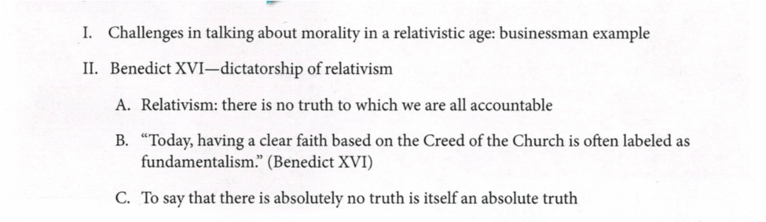
OUTLINE
from Who Am I To Judge Study Guide p 9

Slide 9
Reflection 1
What stood out for you as you watched Dr. Sri’s talk?
Do you think most people are relativists?
What is your view of morality, is it 1) a system of rules to be followed, or 2) guidelines that allow for flexibility, or simply 3) “Do whatever you want, just don‘t hurt anyone else!” Why?
How was your “moral compass” influenced by your family growing up? How was it influenced by the culture after you left home?
Do you find it difficult to talk about moral issues with others who may not fundamentally agree with you?

Slide 10
PART TWO
Please open FORMED and view
Who Am I to Judge?
Session 1
Don’t Impose Your Morality on Me!
Beginning at 14:04

Slide 11
OUTLINE
from Who Am I To Judge Study Guide pp 9-10

Slide 12
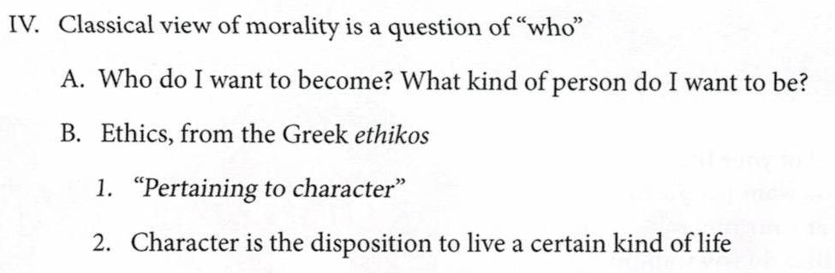
OUTLINE
from Who Am I To Judge Study Guide pp 9-10

Slide 13
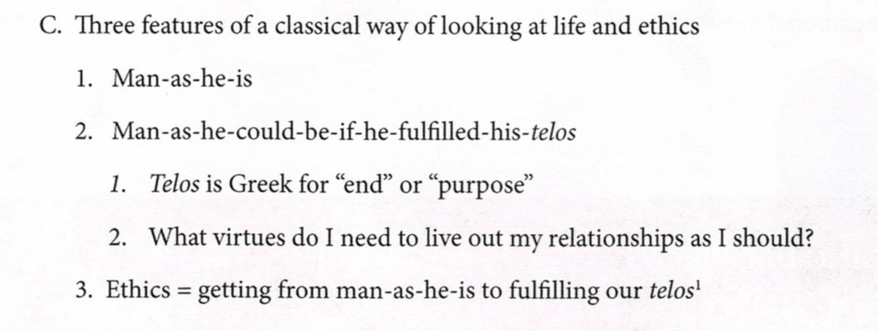
OUTLINE
from Who Am I To Judge Study Guide pp 9-10

Slide 14
Reflection 2
What stood out for you as you watched Dr. Sri’s talk?
Can you describe a “moral moment” in your life?
St. John Paul II taught that by our day to day moral decisions we become a good person or an evil one, do you think this is true? Why? (see The Acting Person, p )
How would you characterize “man-as-he-is” in our culture?
In what ways can you describe the TELOS (goal) of a person?
What are the most important relationships in your life? How do you maintain them?

Slide 15
Key take away points:
The modern view of morality is relativistic and does not allow for absolute moral truths
The Catholic/Judeo-Christian view is classical and allows for truth values (good and bad) in moral decisions
The true end of human beings is love, which necessarily entails relationship, and the virtues help us live that love.

Slide 16
Homework
Pick one virtue that you want to work on (i.e. practice) during this NCF Session. It does not have to be a big Virtue with a capital “v” like Prudence or Temperance, but rather, one of their offshoots. Perhaps your dentist has been after you to take better care of your gums, so you work on developing the virtue of flossing regularly. Or your family doctor has been telling you need to be more active, so you work on the virtue of exercising regularly. You should spend some time in prayer discerning the virtue you want to work on, and then begin to practice the virtue at every opportunity. You can then share your progress at the beginning of our next meeting.

Slide 17
Prayer Partners
Put your name and your petitions on a slip of paper or a card. Fold and throw your cards into a basket, then choose the card of a group member for whom, and for whose intentions, you will pray in the coming weeks.

Slide 18
BEFORE WE MEET AGAIN
Pray for you prayer partner’s needs
Please watch: Virtue and Freedom on FORMED--Episode 1: The Cosmic Struggle nd the Reality of Evil. The Cosmic 1: The Cosmic Struggle and the Reality of Evil

Slide 19
BEFORE WE MEET AGAIN
You may want to purchase:
Who Am I to Judge Workbook—HERE
Or HERE

Slide 20
CLOSING PRAYER
O Almighty and all-knowing God,
without beginning or end,
who are the giver, preserver, and rewarder of all virtue:
Grant me to stand firm on the solid foundation of Faith,
be protected by the invincible shield of Hope,
and be adorned by the nuptial garment of Charity;
Grant me by Justice to obey You,
by Prudence to resist the crafts of the Devil,
by Temperance to hold to moderation, [and]
by Fortitude to bear adversity with patience
Amen
St Thomas Aquinas

