Slide 1
PLEASE SIGN IN
Welcome!

Slide 2
Virtue:
The Art of Living
Meeting 5
Real Freedom,
Real Love
Nativity Communities of Faith
Spring 2023

Slide 3
Opening Prayer
Blessed is the man who does not walk
in the counsel of the wicked,
Nor stand in the way of sinners,
nor sit in company with scoffers.
Rather, the law of the LORD is his joy;
and on his law he meditates day and night.
He is like a tree planted near streams of water,
that yields its fruit in season; Its leaves never wither;
Whatever he does prospers.
Lord, may you ever be my joy!
Help me to grow in virtue and
become the person you made me to be.
Amen

Slide 4
Cor ad Cor Loquitur
Heart Speaks to Heart
Take a few minutes to
re-connect and share
how the Spirit has moved you
in the time since our last meeting.
Notes:
Leader could answer this one first to give an example of what this part means.

Slide 5
Introduction
Workbk p 24

Slide 6
JOURNAL QUESTIONS
Are you likely to read a user manual for something you buy, or do you just like to figure it out as you go? Why?
What freedoms do you have? Which of those is most important to you? Why?

Slide 7
PART ONE
Please open FORMED and view
Who Am I to Judge?
Session 3
Real Freedom, Real Love
Pausing at 14:03

Slide 8
OUTLINE
Workbook p 25

Slide 9
Reflection 1
What stood out for you as you watched Dr. Sri’s talk?
Our TELOS is our end, our ultimate goal; what do you believe is your TELOS?
What virtues are essential to living in a family? How have you put these into practice?
How are the virtues (e.g. justice, prudence, fortitude and temperance) necessary to loving others?
Have you ever heard the idea of “freedom for excellence?” How do you think this ideal of freedom compares with the notion of freedom our culture promotes?

Slide 10
PART TWO
Please open FORMED and view
Who Am I to Judge?
Session 3
Real Freedom, Real Love
Beginning at 14:03

Slide 11
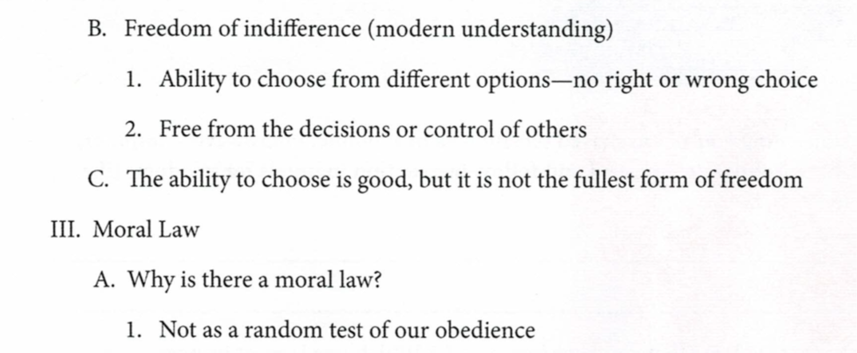
OUTLINE
Workbk p 26

Slide 12
OUTLINE
Workbk p 26

Slide 13
Reflection 2
What stood out for you as you watched Dr. Sri’s talk?
Do you believe the belief that freedom is basically about making choices rather than about the choices you make has become the accepted attitude? What makes you think so?
Why do you think our culture walked away from the classical view of freedom?
When you consider the moral law, what thoughts/images are evoked?
How does God’s love form the moral law? Where do we find the moral law?

Slide 14
Key take away points:
The classical worldview has ethics as the bridge between man-as-he-is and man-as-he-is-meant-to-be. The end (TELOS) of man is love, and so loving relationships are necessary to us and to live them well, we need the virtues so that we are free to love as we should.
Two types of freedom: freedom for excellence vs freedom of indifference. Freedom of Indifference is all about making choices, as long as they are your choices but freedom for excellence is about making the right choices according to the moral law.

Slide 15
Prayer Partners
Put your name and your petitions on a slip of paper or a card. Fold and throw your cards into a basket, then choose the card of a group member for whom, and for whose intentions, you will pray in the coming weeks.

Slide 16
Homework
Re-read the Sermon on the Mount (Mt 5-7)
  How does this “New Law” compare to the Ten Commandments?
  In what way does Jesus fulfill the moral law?
  How does being a disciple of Jesus make it easier to live in God’s law?
Is there a particular moral teaching of the Church you have difficulty with? Spend some time in prayer to the Lord to open your heart to the truth. Look up the teaching in the Catechism of the Catholic Church and see what the “official teaching” is and why it is taught.

Slide 17
BEFORE WE MEET AGAIN
Pray for you prayer partner’s needs
Watch Virtue and Freedom Episode 4
Please note:You will need to buy access on FORMED ($19.95) or buy the videos from Ignatius Press

Slide 18
CLOSING PRAYER
O Almighty and all-knowing God,
without beginning or end,
who are the giver, preserver, and rewarder of all virtue:
Grant me to stand firm on the solid foundation of Faith,
be protected by the invincible shield of Hope,
and be adorned by the nuptial garment of Charity;
Grant me by Justice to obey You,
by Prudence to resist the crafts of the Devil,
by Temperance to hold to moderation, [and]
by Fortitude to bear adversity with patience
Amen
St Thomas Aquinas

